Slide 1
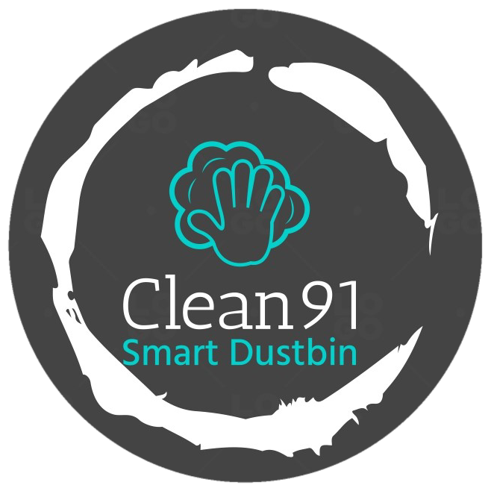
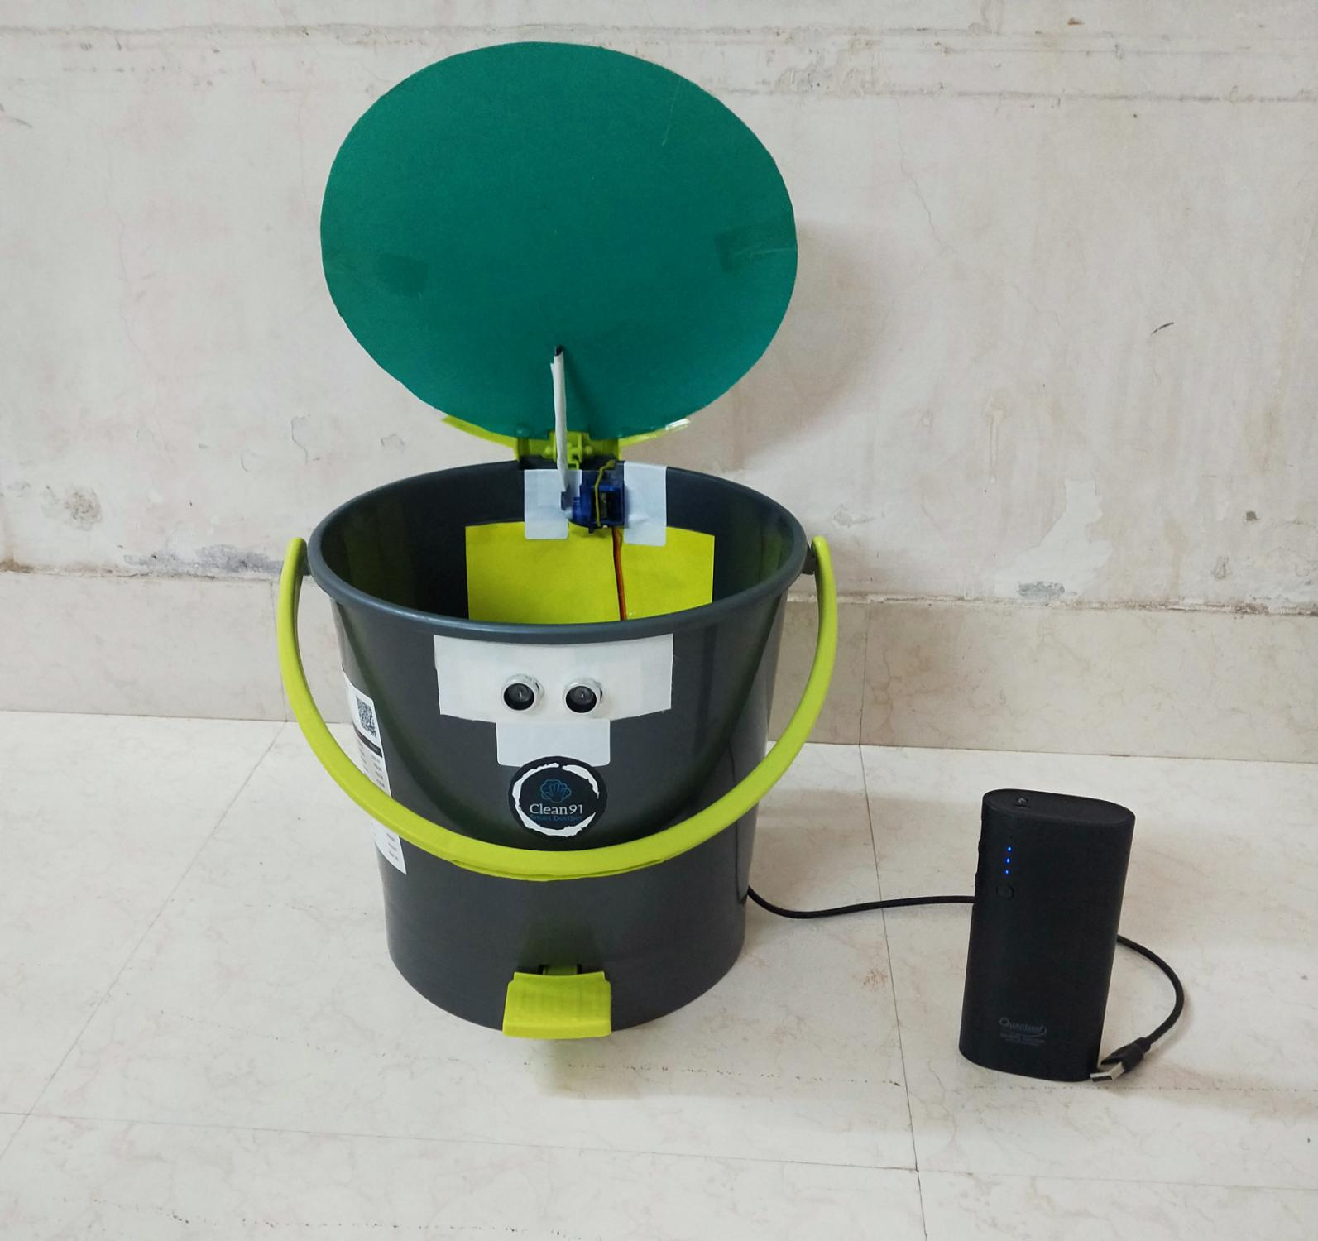
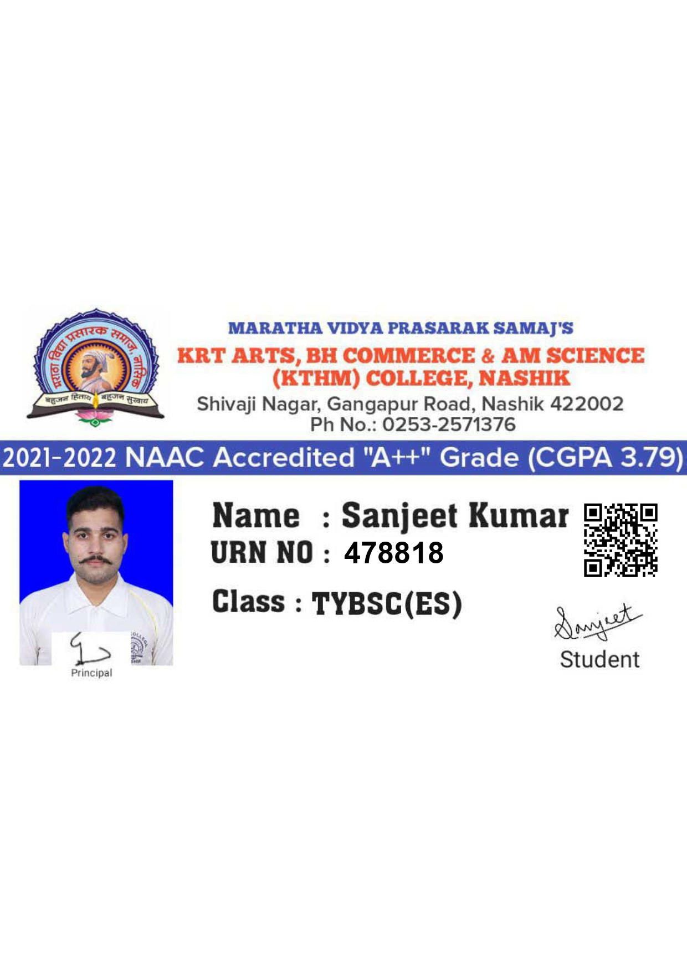
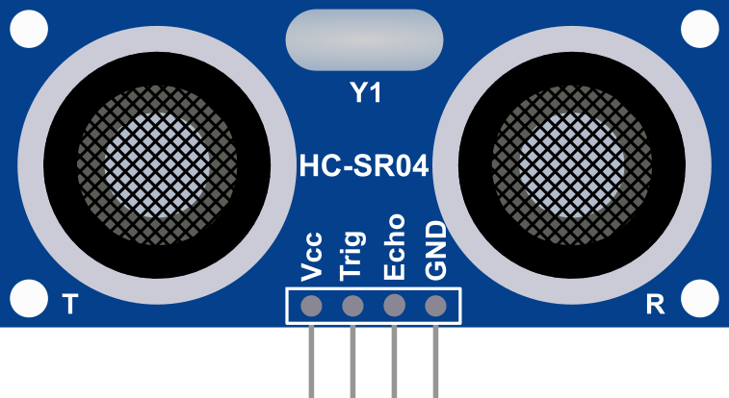

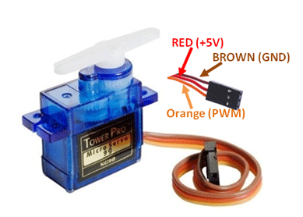
SMART DUSTBINS FOR SMART CITIES
CLEAN91
Roll No. 29
EL 369: Paper IX:
Practical Course III(Project)
2021-2022

Slide 2
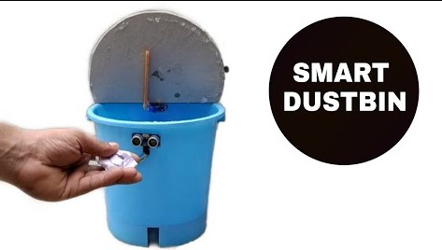
SMART DUSTBINS FOR SMART CITIES
CLEAN91 Smart Dustbin(Mini)

Slide 3
INTRODUCTION
SMART DUSTBIN is an IOT based project that will bring a new and smart way of cleanliness. It is a decent gadget to make your home clean, due to practically all offspring of home consistently make it grimy and spread litter to a great extent by electronics, rappers and various other things. Since the smart dustbin is additionally intriguing and children make fun with it so it will help to maintain cleanliness in home.

Slide 4
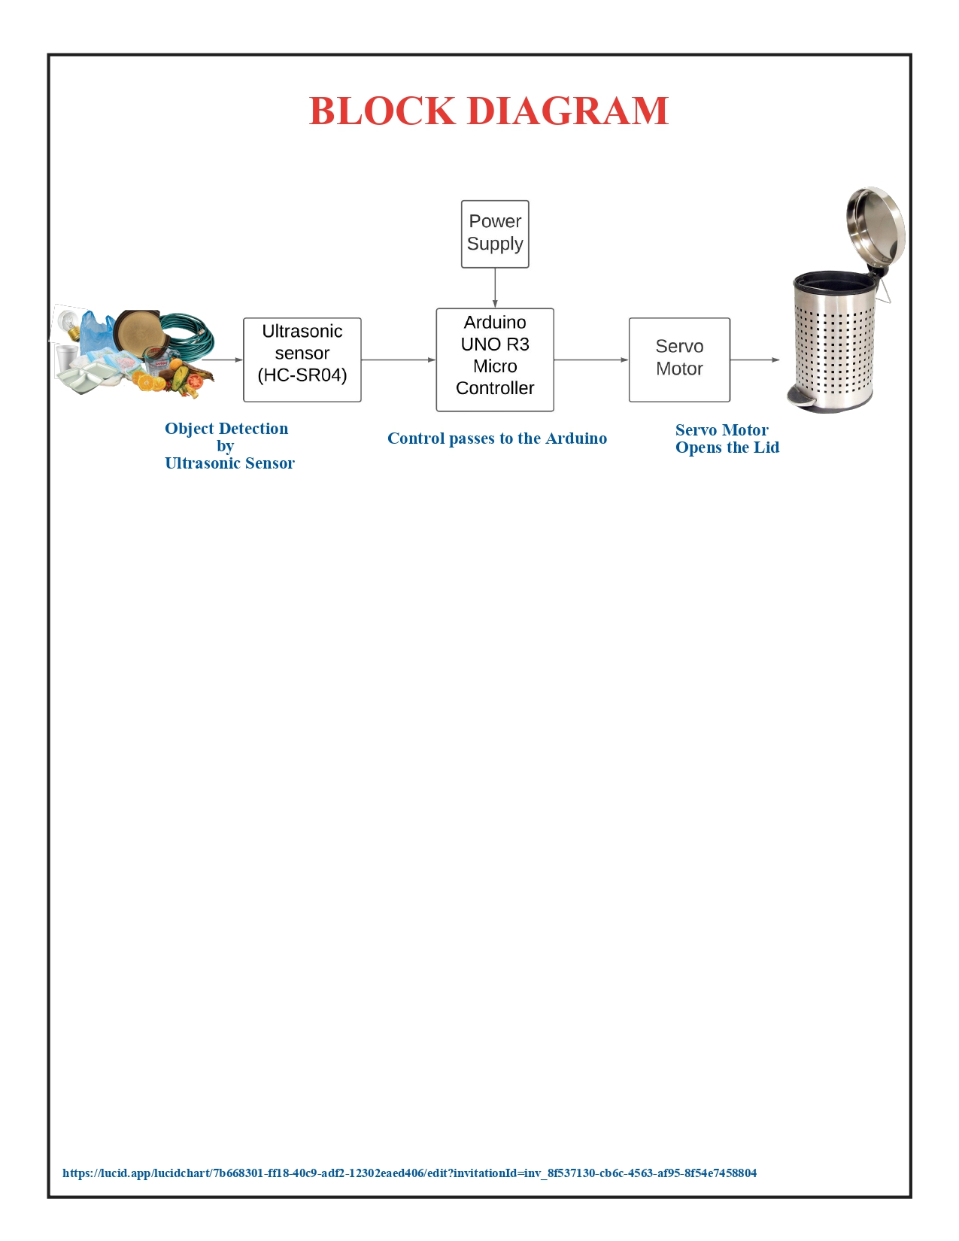

Slide 5
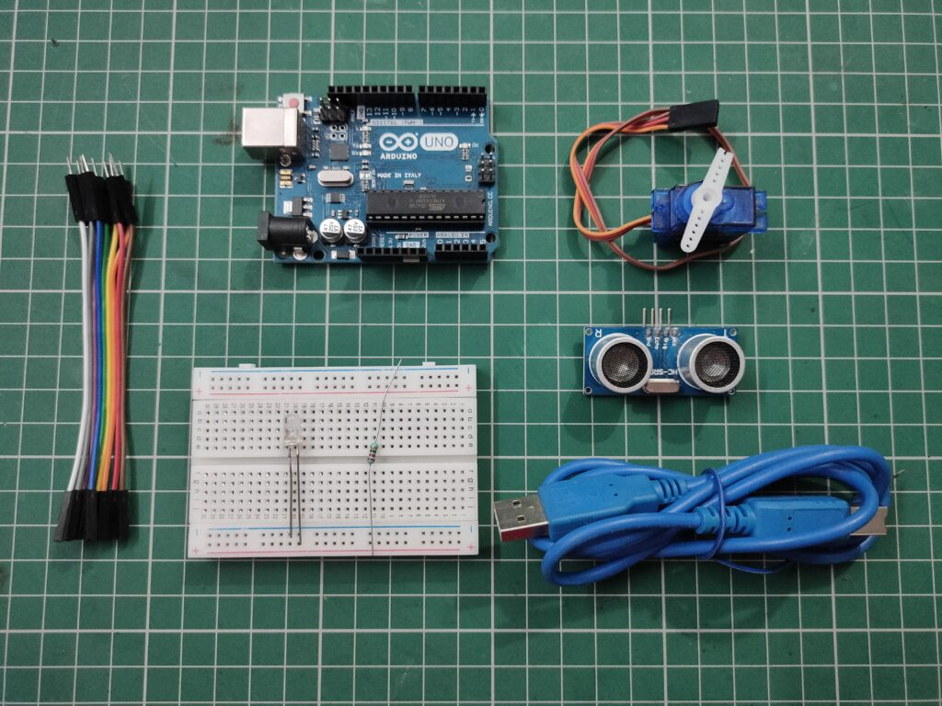
COMPONENT

Slide 6
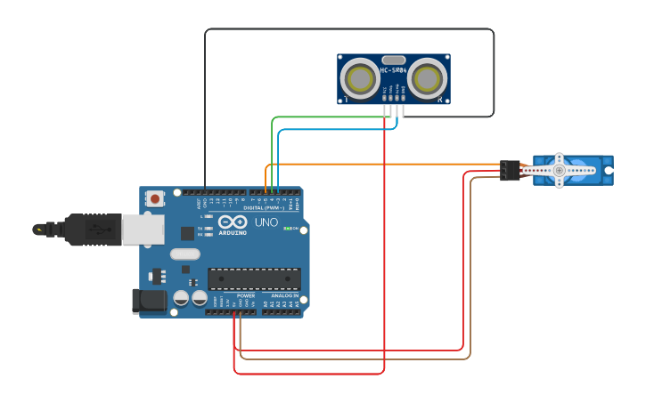
CIRCUIT DIAGRAM (CONNECTION DIAGRAM)

Slide 7
After wiring and attaching all the devices and setting up to the Smart Dustbin, now observe all the important setup whether they are well connected or something missed.

Slide 8
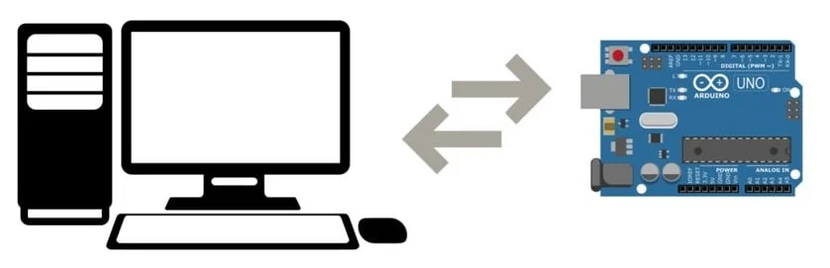
After connection set up now next step is to
submit/upload code in Arduino and supply power
to the circuit.

Slide 9
WORKING
When system is powered ON, Arduino keepsmonitoring for any things that come near thesensor at give range.
When Ultrasonic sensor detect any object forexample like hand or others, here Arduinocalculates its distance and if it less than a certainpredefines value than servo motor get activate first and with the support of the extended arm of the lid.
Lid will open for a given time than it willautomatically close.

Slide 10
APPLICATION
Smart Trash Bin can be used in Colleges/University Campus, Shopping malls,Railway stations (We can use Wi-Fi modules for sending SMS to garbage collector).

Slide 11
ADVANTAGES
1) Automatic open-close lid for ease of use.
2) There is no contact touch between dustbin and Person so, prevention from germs and diseases.
3) Warning message indication when a Smart Trash Bin is nearly full. Also send SMS to garbage collector in particular area.

Slide 12
4) Healthy Environment maintained in particular area.
5) Efficient cleaning of garbage.
6) Helpful for the municipality.
7) On time collection of garbage.
8) No bad odour around the bin.
9) A reduction in the number of waste collections needed by up to 80%, resulting in less manpower, emissions,fuel use and traffic congestion.

Slide 13
10) A reduction in the number of waste bins needed.
11) It will help in bringing evolution by technology in termof cleanliness.

Slide 14
CONCLUSION
For social it will help toward health and hygiene,as many possible. So that normal people to rich people can take benefit from it. Believe this will bring something changes in term of cleanliness as well technology.So my next work will be adding one more sensor which will sense whether our dustbin is full or not. And there will be a display will be added so that user can notify that dustbin is full or not.

Slide 15
FUTURE ENHANCEMENT
There can be many enhancements done for this prototype which can be a revolutionary change in maintaining our environment clean and healthy.The few enhancementscan be done are:
The implementation of more collective bins placed side by side where it automatically detects the type and waste and places in the correct bin color which is assigned for that type.These dustbins can be placed with a GPS tracker where the dustbins in a particular locality can be located easily and the waste can be emptied. This method can lead to Smart Waste Monitoring System.

Slide 16
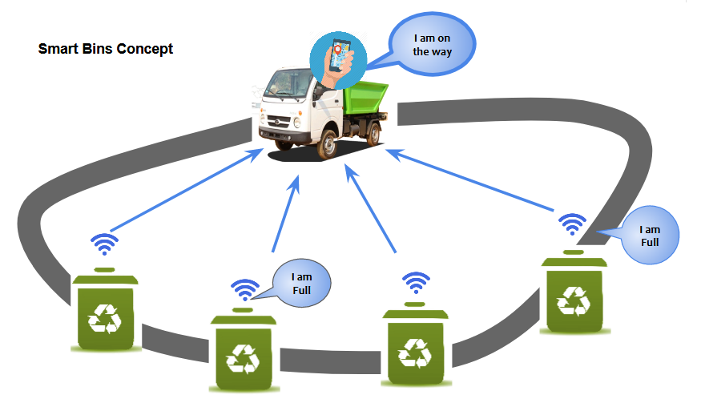

Slide 17
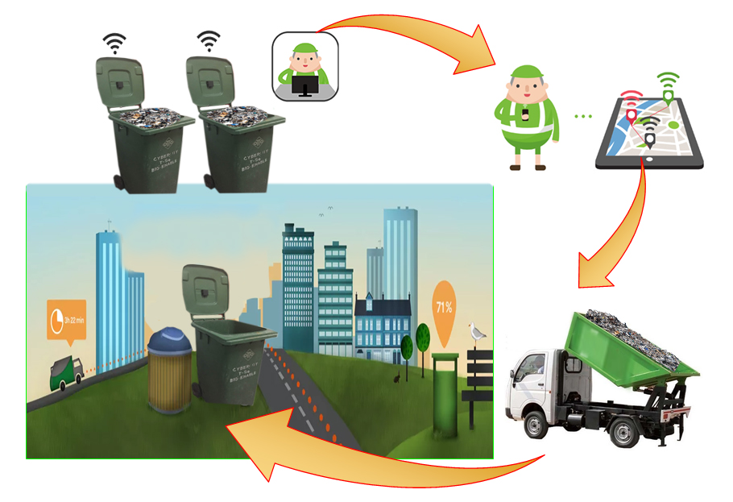
SMART WASTE BIN

Slide 18
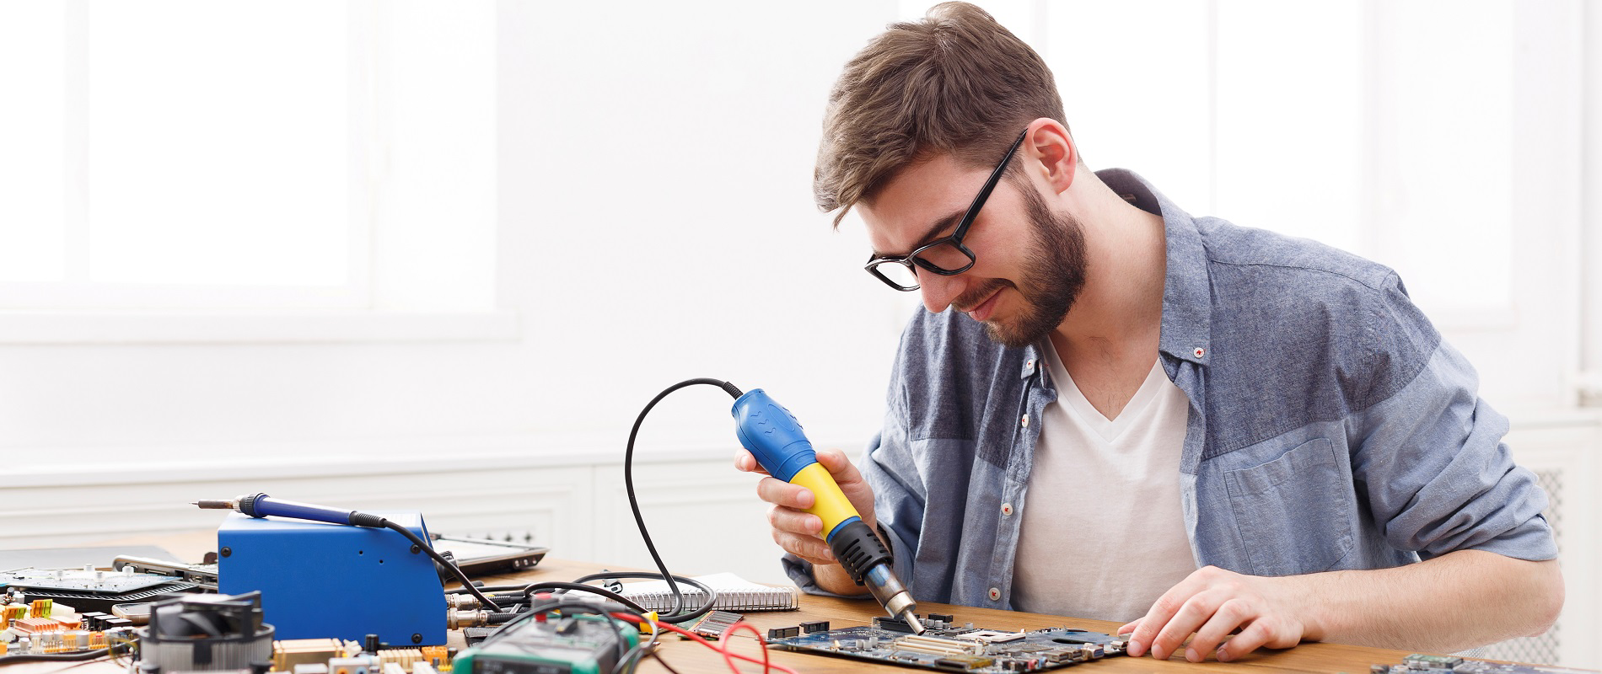
Thank You!

